Slide 1
Just what is (or is not) changing??
Abundance or biomass
Species richness
Dominance or evenness
Species composition (favorable vs unfavorable)
Do the metrics correlate??

Slide 2
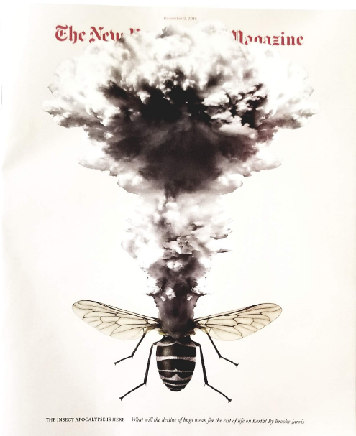
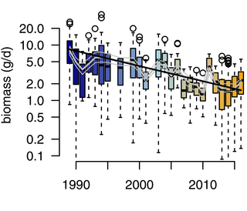
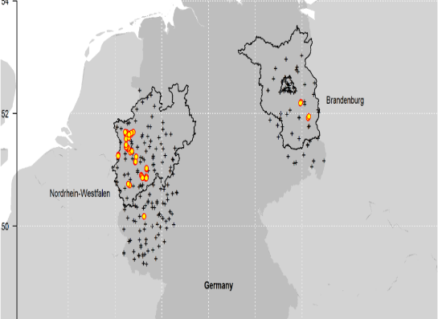
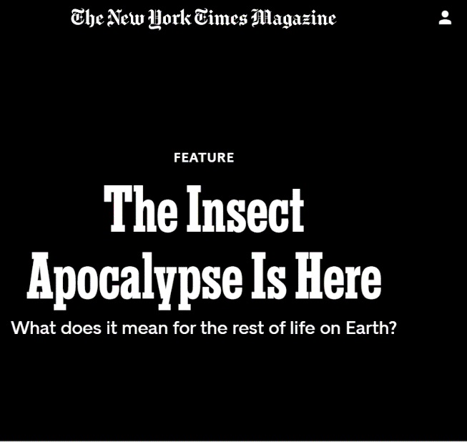
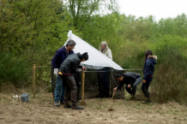
Insect Decline
2542 citations in Google Scholar

Slide 3
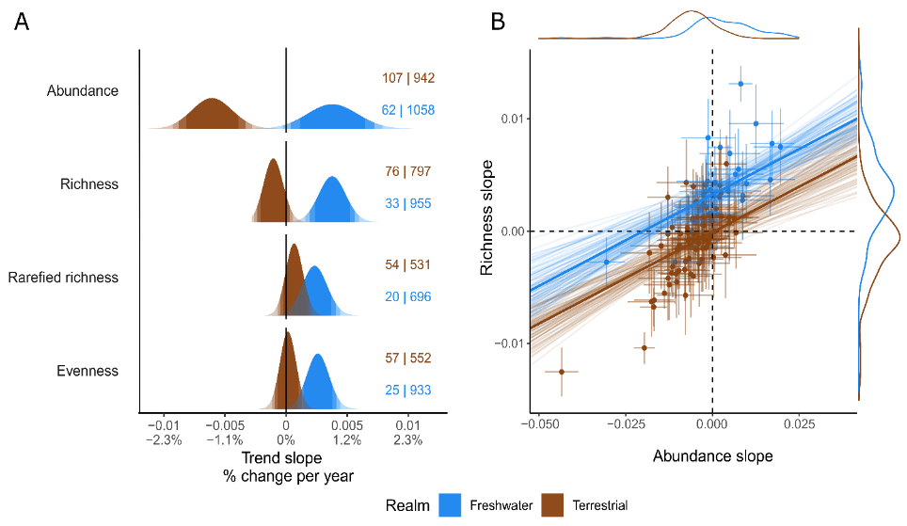
Van Klink et al. unpublished

Slide 4
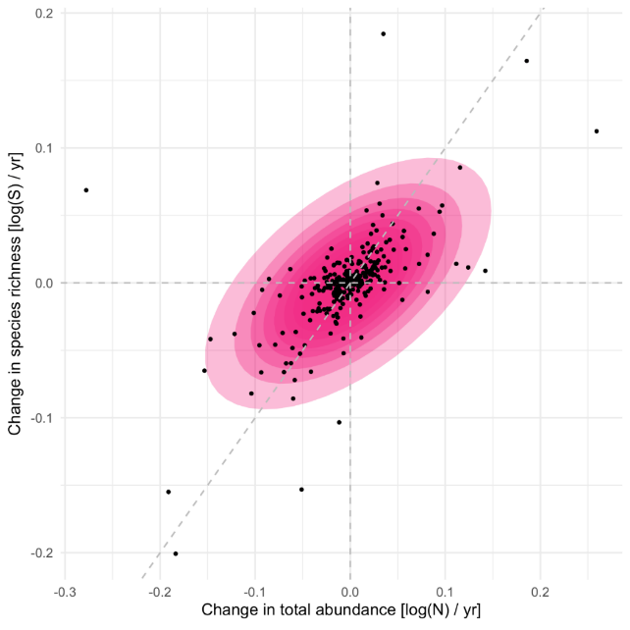

Abundance change and richness change are NOT the same thing!!!
Blowes et al. 2022, Ecology.

Slide 5
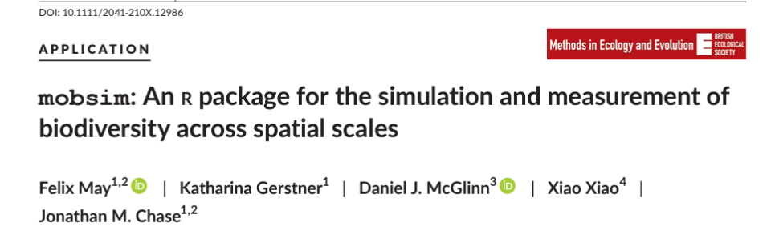

Biodiversity across scales
Number of individuals
Species relative abundances
Spatial distribution
(e.g. aggregation)
Biodiversity drivers (Land use, climate, invaders, …)
package mobsim

Slide 6
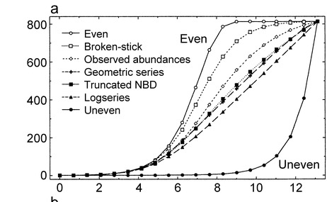
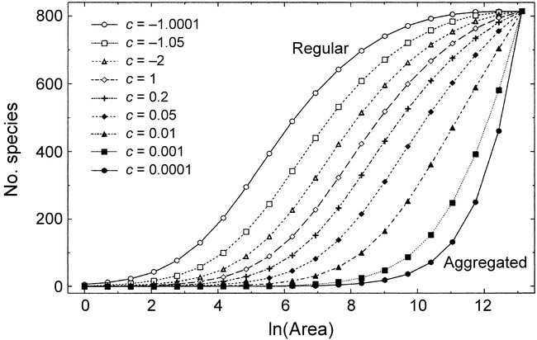
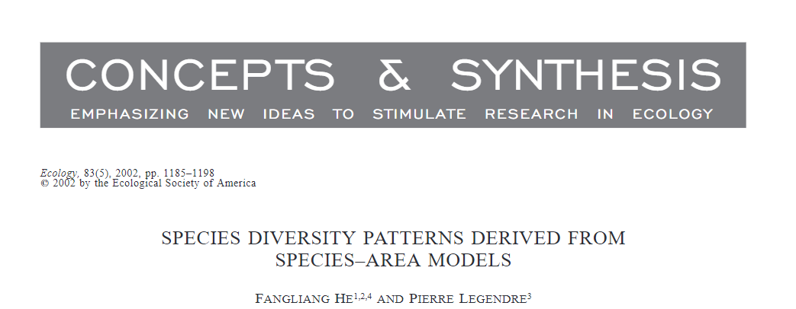
Relative abundance and aggregation drive the SAR

Slide 7
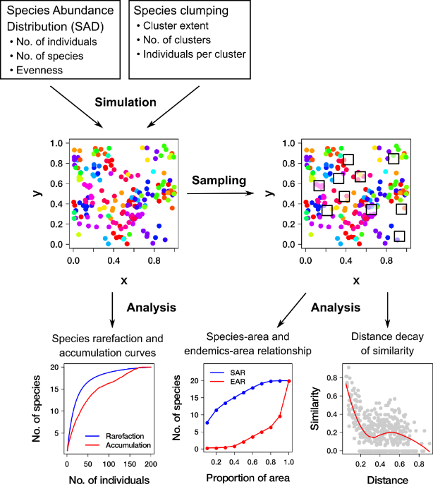

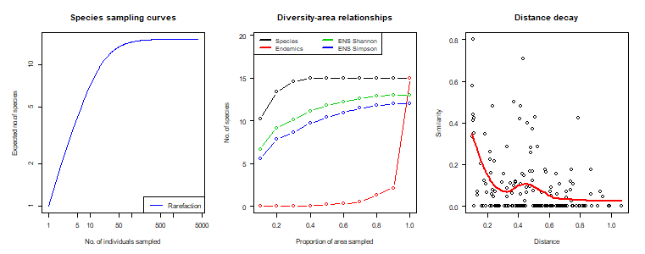
package mobsim
https://github.com/MoBiodiv/mobsim

Slide 8
Update R
Install the RTools version corresponding to your OS and R version
Run these three lines in R:
install.packages(c('shiny', 'shinyBS','pals','shinyjs', 'devtools','DT','markdown'))
devtools::install_github('albansagouis/mobsim@master')
shiny::runGitHub("albansagouis/mobsim_app", ref = "master")
https://sagouis.shinyapps.io/mobsim_app/
(Free version, so can’t host too many people at once)

Slide 9
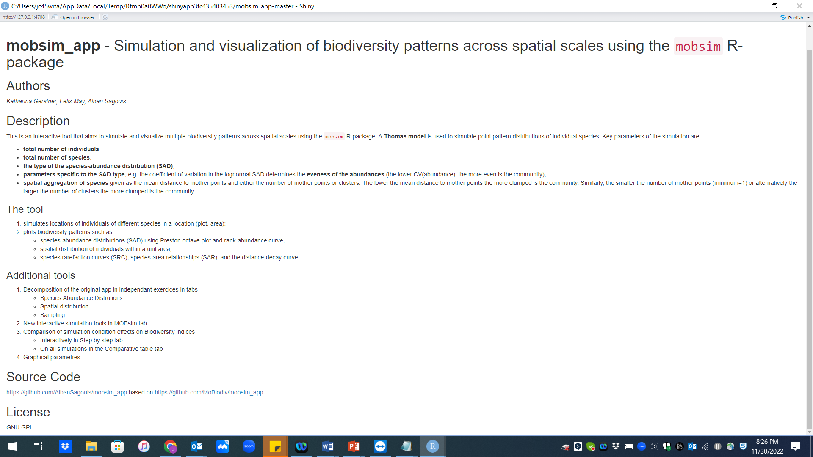

Slide 10
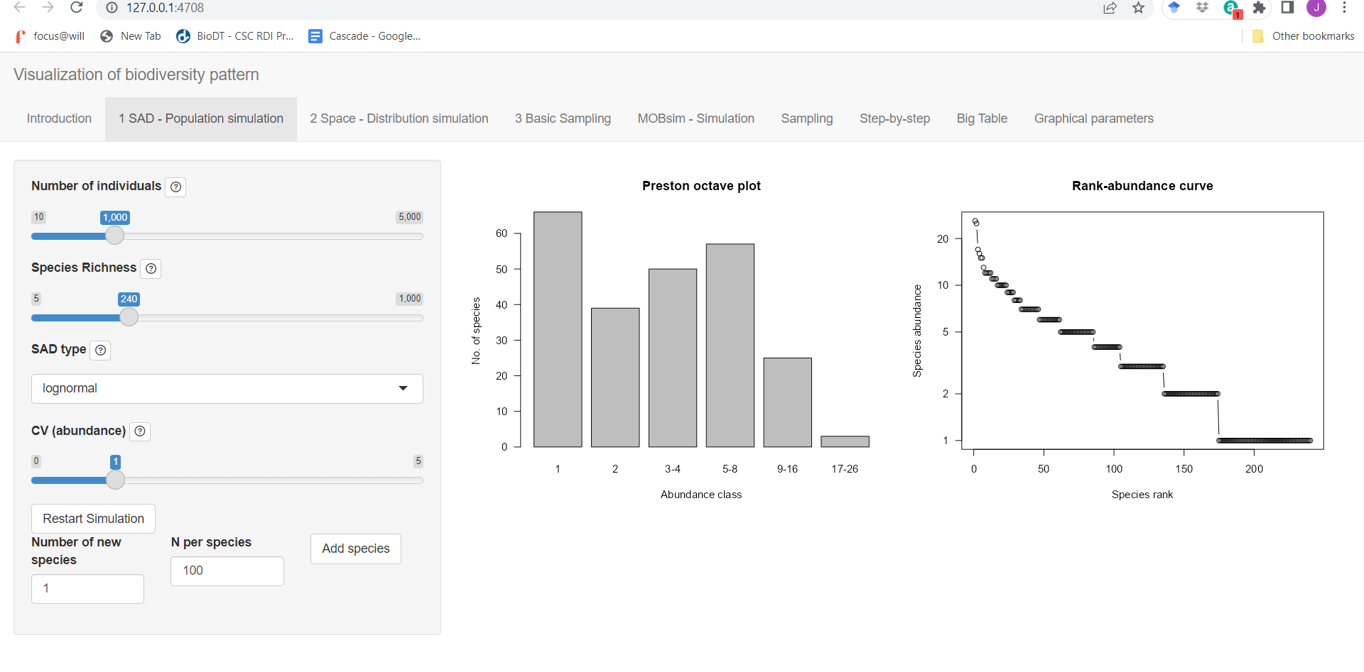

Slide 11
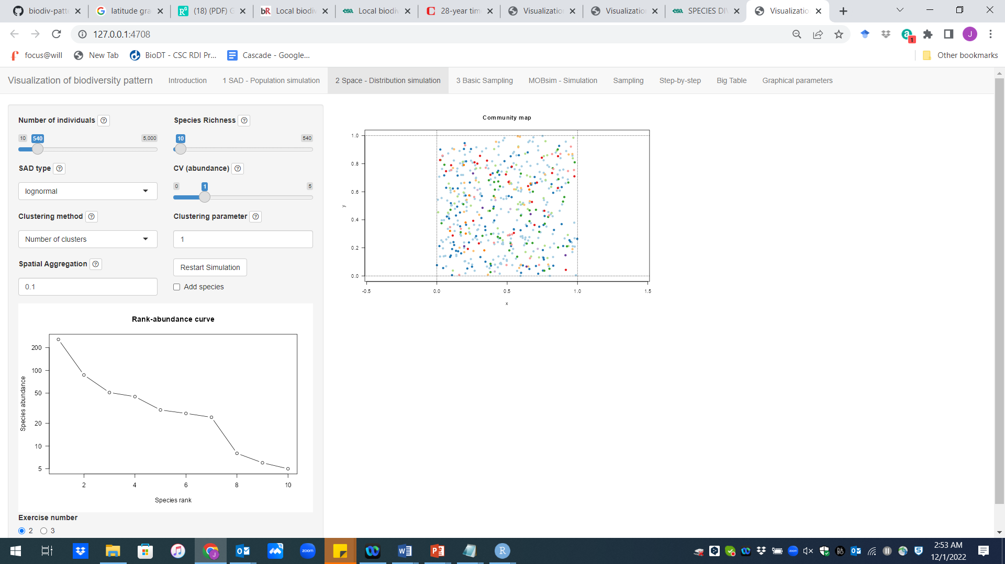
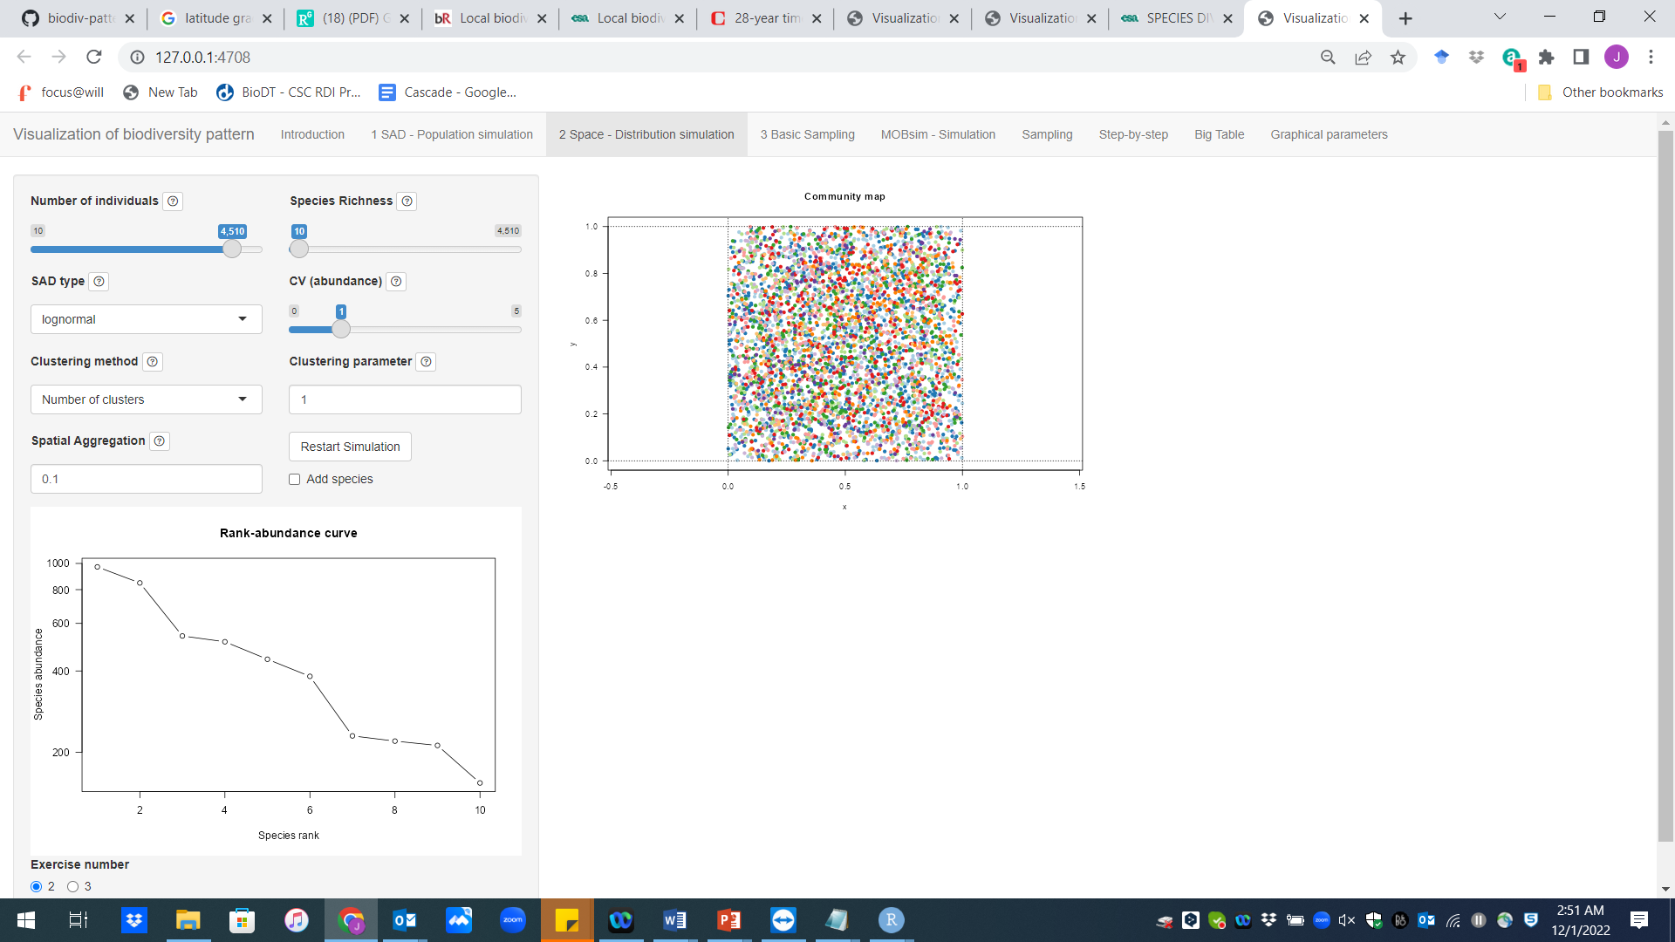
Relative abundance (Species Abundance Distribution—SAD)

Slide 12
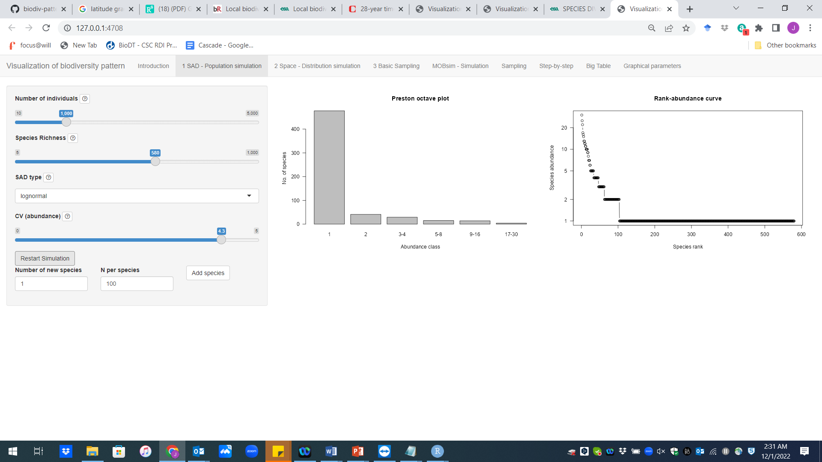
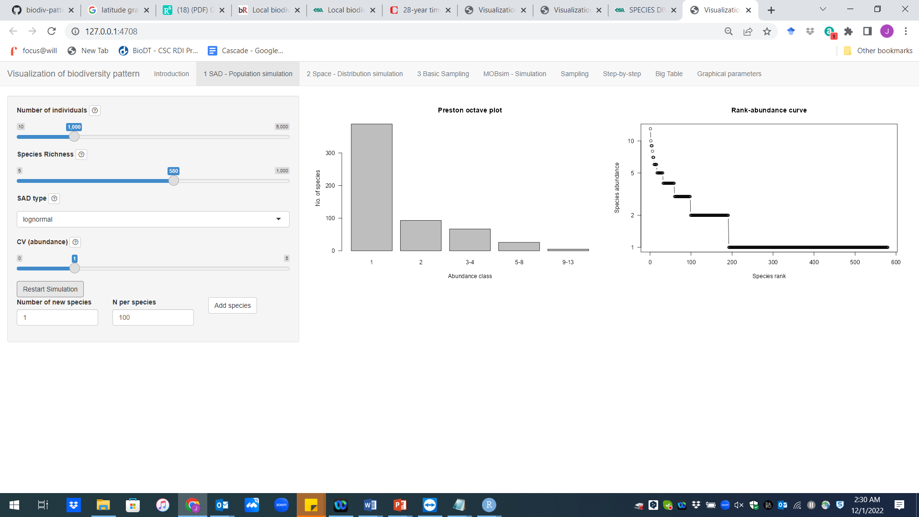
Relative abundance (Species Abundance Distribution—SAD)

Slide 13
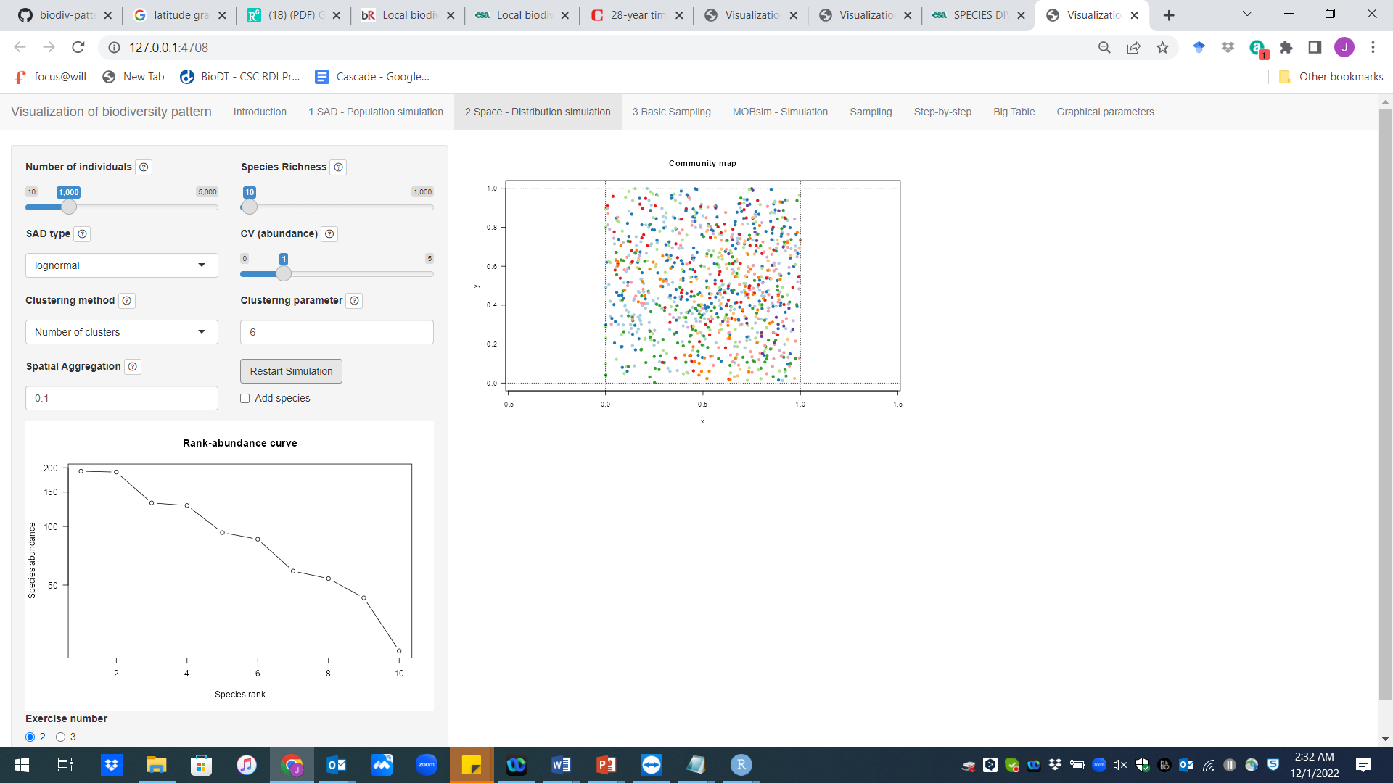
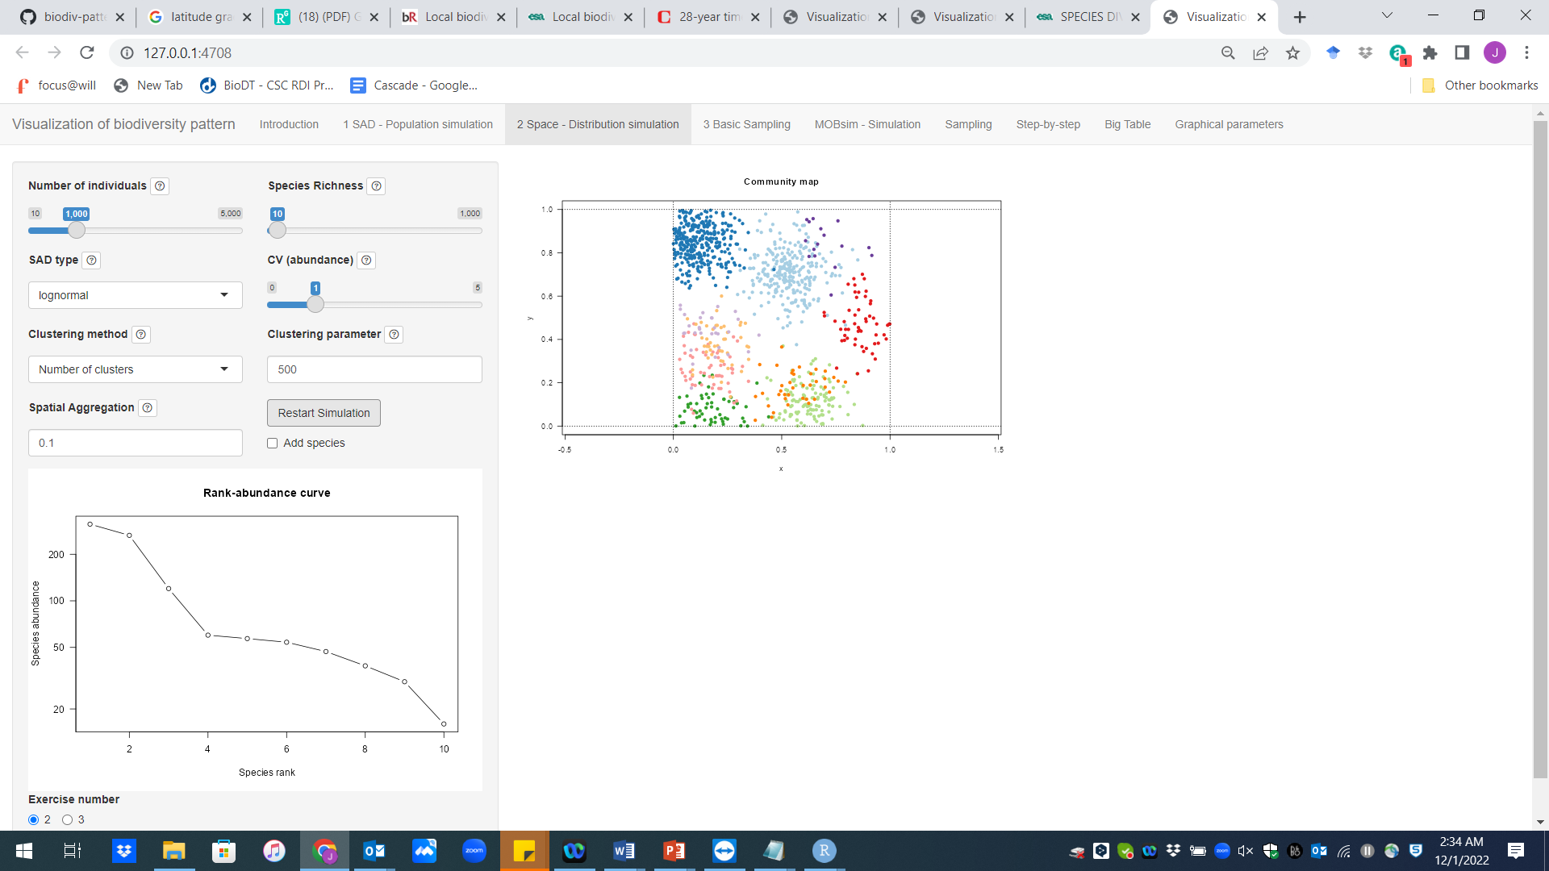
Clustering pattern

Slide 14
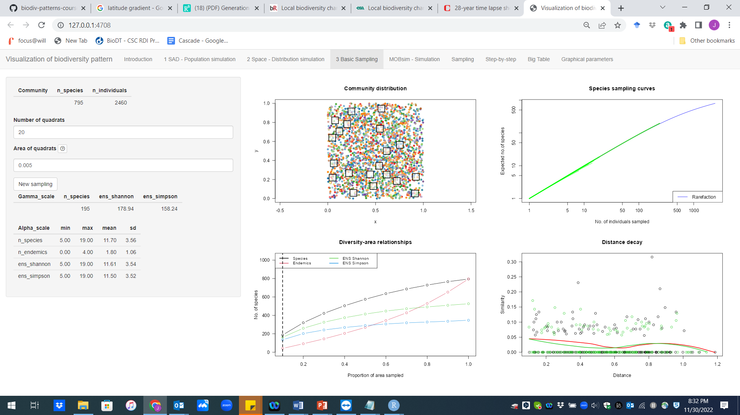

Slide 15
5 minute break
15 minutes simulation/discussion in small groups
10 minute discussion in larger group
How are N, the SAD and the SAR linked?
-What does changing the N do? ‘
-What does changing the evenness (CV) do?
How does spatial clumping (aggregation) influence the SAR?
-What does changing the clusters (or mother points) do?

Slide 16
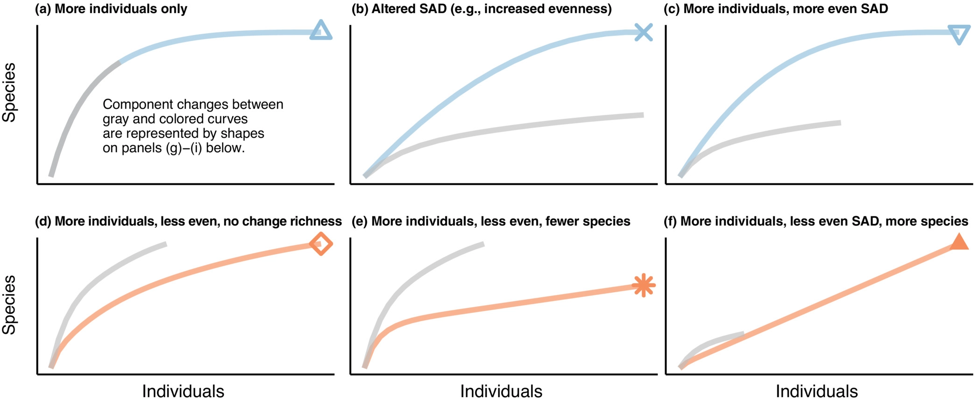
Blowes et al. 2022, Ecology

